Slide 1
Transitioning to CA PPM On Demand
Get the Results You Need When You Need Them
Presented by: Joshua Leone

Slide 2
Agenda
Where do you start
On Premise versus SaaS
Advantages
Migrating
Running

Slide 3
Let’s start with some questions
Have any of you made the move to SaaS?
Would you do it again?
Did any of you start with SaaS?
What has your experience been like?
How many of you are planning to move to SaaS?
What are your biggest concerns?
Who will never move to SaaS?
Why?

Slide 4
On Premise versus SaaS
On Premise
Purchase Perpetual CA PPM licenses with annual maintenance
Gives company total system control
Very common with large instances and industries where information cannot be outside of company firewall
SaaS
Software As A Service with annual payments and no perpetual license
Accessing a common, central system removes all ability to customize
Must remain on a supported version, but upgrades are much easier
Most common hosting method for new customers

Slide 5
Advantages Matrix (which method has the advantage)
Operation | On Premise | CA SaaS | Comments
Infrastructure
OS Responsibility |  | ✓ | CA SaaS handles all operating system responsibilities
Load Balancer |  | ✓ | CA SaaS handles all load balancer setup and configurations
Database
Direct database access | ✓ |  | CA SaaS will allow Read-Only access to the database only with 5 accounts
Database management | ✓ |  | CA SaaS manages all database. No customer access for settings changes. CA SaaS will utilize the best practice for the Oracle optimization. Not configurable at the customer end.
GEL Database Updates | ✓ |  | CA SaaS will not support direct database updates, but they do not currently restrict them. If a script causes a database issue, it is the client’s responsibility to remediate making CA not liable.
Reporting
Utilize any BI solution | ✓ |  | CA SaaS will provide access to Business Object and Jaspersoft (as of 14.2) for reporting within Clarity – no external data warehouse connection allowed
Utilize native Business Objects functionality | ✓ |  | CA SaaS provides limited support/access to Business Objects. Not all features (like emailing reports) are available
Advantages Matrix (Which Method Has the Advantage)

Slide 6
Advantages Matrix (which method has the advantage)
Operation | On Premise | CA SaaS | Comments
Authentication
Direct LDAP support | ✓ |  | CA SaaS provides integrated authentication via the CA Portal. No direct integration to a customer LDAP system.
Federated SSO support | ✓ | ✓ | CA SaaS provides federated SSO support. The customer just need s to have an identity.
Connectivity
VPN Required for Clarity |  | ✓ | CA SaaS does not require a VPN for Clarity access. Access is secured via the browser and HTTPS.
VPN Required for Database | ✓ |  | CA SaaS offers a client side VPN (no point to point) so read-only database access can be utilized.
Clarity Administration
Access to the CSA | ✓ |  | CA SaaS controls all CSA based settings. Not client configurable
Integrations
Direct database link | ✓ |  | CA SaaS does not allow direct database integrations. Flat file via SFTP transfer or XOG can be used
Advantages Matrix (Which Method Has the Advantage)

Slide 7
Advantages Matrix (which method has the advantage)
Operation | On Premise | CA SaaS | Comments
Business Factors
Upgrades | ✓ | ✓ | CA SaaS provides the ability to reduce the duration and cost of upgrades – the technical upgrade being performed by CA. SaaS does not provide the ability to leverage the full set of upgrade logs and data to ensure all aspects of the upgrade are successful.
Version Control | ✓ |  | CA SaaS requires that a company stay on a supported version
External Data Access | ✓ |  | CA SaaS leaves a companies data accessible outside of a company firewall
Performance
Overall Performance | ✓ | ✓ | CA SaaS has a proven track record of solid performance, but 95% of clients are less than 5K users. On premise can have very solid performance, but tuning for performance is expensive.
Performance Analysis | ✓ |  | CA SaaS does not allow access to companies to certain performance related data. CA is responsible for all performance testing and improvement.
Database Performance Objects | ✓ |  | CA SaaS will not allow custom database triggers, procedures, functions, or views that may be needed in larger instances to improve application performance for core functions – reports, portlets, workflows
Advantages Matrix (Which Method Has the Advantage)

Slide 8
Migrating to SaaS
CA’s On Premise to SaaS conversion program
FREE!
Will convert you to Oracle if on SQL Server
Will upgrade you to the latest available release
Discovery script to identify customizations
Report detailing all items that need investigation
Will NOT migration customizations
Customization Remediation
Customer or Services partner responsibility

Slide 9
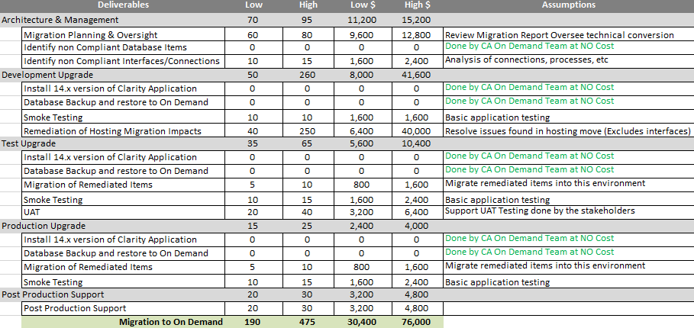
Sample Costs

Slide 10
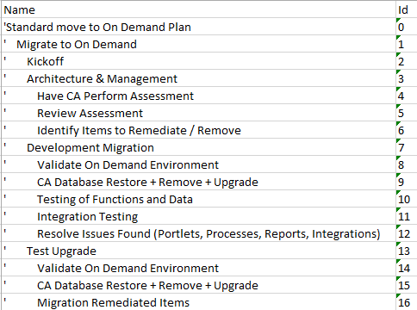
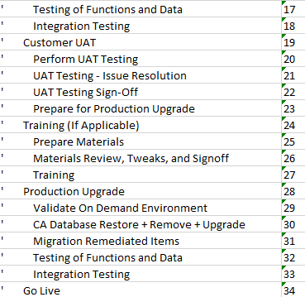
Sample Plan

Slide 11
Running on SaaS
Handoff/Introduction
Know and understand the maintenance schedule
Interacting with CA Support
Learn the CA SaaS portal (if utilizing)
Remember the restrictions
Be prepared for patches and upgrades

Slide 12
Questions
We hope that you found this session informative and worthwhile. Our primary goal was to increase your understanding of the topic and CA PPM in general.
There were many concepts covered during the session, if you would like to contact any presenter with questions, please reach out to us.
Thank you for attending regoUniversity 2015!
Phone
888.813.0444
Email
info@regouniversity.com
Website
www.regouniversity.com

