Slide 1
Getting Started with Data Model
Reporting Tables, Writing Queries, and More
Presented by: Juan Ortega, David Zywiec | Date Prepared: May 4, 2015

Slide 2
Agenda
SQL Basics
Clarity Core Tables
Investments (Projects, Ideas)
Resources / Users
Lookups
Time Reporting
Time Slices

Slide 3
Requirements
SQL Developer
  SQL Developer: Here
Clarity DB Connection Info and Access
  Place holder for information

Slide 4
SQL Basics
SELECT Statements
JOIN Statements
WHERE Clause
GROUP BY
ORDER BY
Best practices: Try to use ANSI SQL syntax

Slide 5
SQL Basics, cont.
The SELECT statement retrieves column data from tables
  NSQL Queries must start with SELECT however for each column
The FROM clause is a standard SQL statement that defines which table to gather data from
The WHERE statement filters data returned by a query
The GROUP BY clause is typically used to combine database records with identical values in a specified field into a single record, usually for the purposes of calculating some sort of aggregate function
The ORDER BY clause is used to sort data on a column
  The sort can be ascending or descending
  Use the acronym ASC or DESC

Slide 6
JOIN Types
INNER JOIN
  Return rows when there is at least one match in both tables
LEFT JOIN
  Return all rows from the left table, even if there are no matches in the right table.

Slide 7
Core Tables
Investments
  INV_Investments is the basic investment table that links to all of the related investment tables
Resources
  SRM_Resources is the basic resource/role table that links to all resource related tables
Timesheet
  Stores timesheet information and links to the resource, time entry, and time period tables
Investments
INV_INVESTMENTS
Core Tables
Resource
SRM_Resources
Timesheet
PRTimeSheet

Slide 8
Activity #1
Retrieve all Projects from the INV_INVESTMENTS table with Type = Project and Project is Active
Retrieve Project ID, Project Name, and Project Manager Full Name (Last Name, First Name)

Slide 9
Queries – Activity #1
SELECT * FROM INV_INVESTMENTS inv
WHERE inv.ODF_OBJECTTYPE = ‘project’
AND inv.is_active = 1
SELECT inv.code, inv.name, r.full_name
FROM INV_INVESTMENTS inv
INNER JOIN SRM_RESOURCES r on r.user_id = inv.manager_id

Slide 10
Queries – Activity #1
Preferred Way
SELECT inv.code, inv.name, r.full_name
FROM INV_INVESTMENTS inv
INNER JOIN SRM_RESOURCES r on r.user_id = inv.manager_id
Non-Preferred Way
SELECT inv.code, inv.name, r.full_name
FROM INV_INVESTMENTS inv , SRM_RESOURCES r
WHERE r.user_id = inv.manager_id

Slide 11
Resources vs. Users
Resources vs. Users (Application side vs. Administration Side)
Resources are records on the Application side.
  Can be named resources or roles
  TABLE: SRM_RESOURCES
USERS that have the ability to log into CA PPM
  TABLE: CMN_SEC_USERS

Slide 12
Resources vs. Users, cont.
SRM_RESOURCE table has a JOIN with CMN_SEC_USERS
  SELECT r.full_name, u.last_name, u.first_name
  FROM SRM_RESOURCES r
  INNER JOIN CMN_SEC_USERS u on u.id = r.user_id
Shortcut: Always use SRM_RESOURCES if possible to avoid querying the CMN_SEC_USERS table
Exceptions: Security, User_name

Slide 13
Activity #2
Retrieve all USERS where their status is locked
Retrieve all RESOURCES where Open for Time Entry is True

Slide 14
Queries – Activity #2
SELECT *
FROM CMN_SEC_USERS u
WHERE u.user_status_id = 202
-- 202 = locked, 201 = inactive, 200 = active
SELECT *
FROM SRM_RESOURCES r
WHERE r.person_type = 300
-- 300 = Employee, 301 = Contractor

Slide 15
Custom Fields on Core Tables
All Custom tables begin with ODF_CA_
Each Core table has a unique Custom Table that contains the custom fields created on the Object
  Projects: ODF_CA_PROJECT
  Investments: ODF_CA_INV
  Resources: ODF_CA_RESOURCE
  Task: ODF_CA_TASK

Slide 16
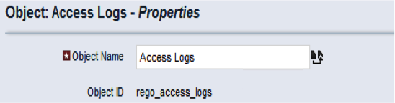
Custom Objects
All Custom Objects have a unique table
All custom object tables begin with ODF_CA_ (object_id)
The table for this Custom Object is
  ODF_CA_REGO_ACCESS_LOGS

Slide 17
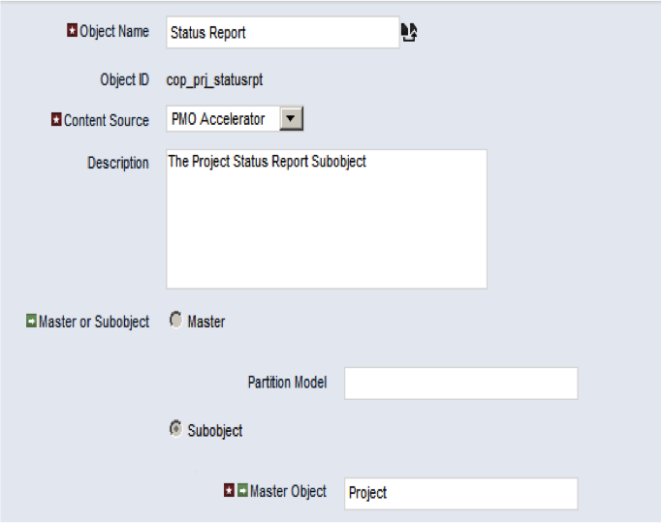
Custom Objects, cont.
Custom Objects can be either a Master Object or Subobject
Subobjects will always have a Parent
Examples of Subobjects are
  Status Report

Slide 18
Custom Objects, cont.
Subobjects are linked to their Parent with the column
  ODF_PARENT_ID
Example:
  SELECT ODF_PARENT_ID
  FROM
  ODF_CA_COP_PRJ_STATUSRPT

Slide 19
Activity #3 – Custom Object
Create one Custom Object (Master)
  Populate Custom Object with 3 records
  Retrieve all records using SQL
Retrieve all Status Reports for a Project and include
  Project ID
  Project Name
  Status Report Name
  Report Status

Slide 20
Queries – Activity #3
SELECT *
FROM ODF_CA_OBJECT_ID
SELECT inv.code, inv.name, rpt.name, rpt.cop_report_status
FROM INV_INVESTMENTS inv
INNER JOIN ODF_CA_COP_PRJ_STATUSRPT rpt on rpt.odf_parent_id = inv.id
WHERE inv.code = ‘PRJ5555’

Slide 21
Lookups
2 Type of Lookups: Static & Dynamic
  Dynamic Lookups are SQL based; use your SQL skills to create a dynamic Lookup
  Static Lookups are values that you set
To retrieve these values in a Query, use the following VIEW provided by CA PPM
  CMN_LOOKUPS_V

Slide 22
Activity #4 – Lookups
Retrieve value of Idea Type for a Project
  SELECT OBJ_REQUEST_TYPE
  FROM INV_INVESTMENTS
  WHERE CODE = ‘XXXXX’
Result: type200

Slide 23
Group Activity #4 – Lookups
Retrieve the display value of Idea Type for a Project
  SELECT v.NAME
  FROM INV_INVESTMENTS inv
  INNER JOIN CMN_LOOKUPS_V v on v.LOOKUP_TYPE = ‘OBJ_IDEA_PROJECT_TYPE’
  and v.LOOKUKP_CODE = inv. OBJ_REQUEST_TYPE and v.LANGUAGE_CODE = ‘en’
  WHERE inv.CODE = ‘XXXXX’
Result: Maintenance

Slide 24
Timesheet Tables
Three main timesheet tables
  PRTIMESHEET
  PRTIMEENTRY
  PRTIMEPERIOD

Slide 25
Group Activity #4 – Timesheets
Retrieve all Timesheets where status = Open (Not Submitted yet)
  SELECT * PRTIMESHEET
  WHERE PRSTATUS = 0
  0 = Open
  1 = SUBMITTED
  2 = RETURNED
  3 = APPROVED
  4 = POSTED
  5 = ADJUSTED

Slide 26
Time Slice Tables
Time and Hour metrics are stored as blobs and are unreadable in the day to day production tables
Time Slice tables open a window to this data for viewing
These views allow CA PPM to group data into Weeks, Months, Quarters, etc.
This grouping allows for more efficient queries
Need to tell it what slice you are going after
Time Slice Management
prj_blb_slicerequests
Time Slice Tables
Time Slice Management Detail
prj_blb_slices

Slide 27
Questions
We hope that you found this session informative and worthwhile. Our primary goal was to increase your understanding of the topic and CA PPM in general.
There were many concepts covered during the session, if you would like to contact any presenter with questions, please reach out to us.
Thank you for attending regoUniversity 2015!
Phone
888.813.0444
Email
info@regouniversity.com
Website
www.regouniversity.com

